Slide 1
DISTRIBUTED FILE SYSTEMS

Slide 2
Topics
File Service Architecture DFS: Case Studies Case Study: Sun NFS Case Study: The Andrew File System
Couloris,Dollimore and Kindberg Distributed Systems: Concepts & Design Edn. 4 , Pearson Education 2005

Slide 3
Introduction
File systems are responsible for the organization, storage, retrieval, naming, sharing and protection of files. Files contain both data and attributes.
Couloris,Dollimore and Kindberg Distributed Systems: Concepts & Design Edn. 4 , Pearson Education 2005

Slide 4
Introduction
File length
Creation timestamp
Read timestamp
Write timestamp
Attribute timestamp
Reference count
Owner
File type
Access control list
Figure 3. File attribute record structure
Couloris,Dollimore and Kindberg Distributed Systems: Concepts & Design Edn. 4 , Pearson Education 2005

Slide 5
Introduction
Distributed File system requirements Related requirements in distributed file systems are: Transparency Concurrency Replication Heterogeneity Fault tolerance Consistency Security Efficiency
Couloris,Dollimore and Kindberg Distributed Systems: Concepts & Design Edn. 4 , Pearson Education 2005

Slide 6
File Service Architecture
An architecture that offers a clear separation of the main concerns in providing access to files is obtained by structuring the file service as three components: A flat file service A directory service A client module.
Couloris,Dollimore and Kindberg Distributed Systems: Concepts & Design Edn. 4 , Pearson Education 2005

Slide 7
File Service Architecture
Client computer
Server computer
Application
Application
Directory service
program
program
Flat file service
Client module
Figure 5. File service architecture
Couloris,Dollimore and Kindberg Distributed Systems: Concepts & Design Edn. 4 , Pearson Education 2005

Slide 8
File Service Architecture
The Client module implements exported interfaces by flat file and directory services on server side. Responsibilities of various modules can be defined as follows: Flat file service: Concerned with the implementation of operations on the contents of file. Unique File Identifiers (UFIDs) are used to refer to files in all requests for flat file service operations. UFIDs are long sequences of bits chosen so that each file has a unique among all of the files in a distributed system.
Couloris,Dollimore and Kindberg Distributed Systems: Concepts & Design Edn. 4 , Pearson Education 2005

Slide 9
File Service Architecture
Directory service: Provides mapping between text names for the files and their UFIDs. Clients may obtain the UFID of a file by quoting its text name to directory service. Directory service supports functions needed generate directories, to add new files to directories.
Couloris,Dollimore and Kindberg Distributed Systems: Concepts & Design Edn. 4 , Pearson Education 2005

Slide 10
File Service Architecture
Client module: It runs on each computer and provides integrated service (flat file and directory) as a single API to application programs. For example, in UNIX hosts, a client module emulates the full set of Unix file operations. It holds information about the network locations of flat-file and directory server processes; and achieve better performance through implementation of a cache of recently used file blocks at the client.
Couloris,Dollimore and Kindberg Distributed Systems: Concepts & Design Edn. 4 , Pearson Education 2005

Slide 11
File Service Architecture
Flat file service interface: Figure 6 contains a definition of the interface to a flat file service.
Couloris,Dollimore and Kindberg Distributed Systems: Concepts & Design Edn. 4 , Pearson Education 2005

Slide 12
File Service Architecture
Read(FileId, i, n) -> Data if 1≤i≤Length(File): Reads a sequence of up to n items
-throws BadPosition from a file starting at item i and returns it in Data.
Write(FileId, i, Data) if 1≤i≤Length(File)+1: Write a sequence of Data to a
-throws BadPosition file, starting at item i, extending the file if necessary.
Create() -> FileId Creates a new file of length0 and delivers a UFID for it.
Delete(FileId) Removes the file from the file store.
GetAttributes(FileId) -> Attr Returns the file attributes for the file.
SetAttributes(FileId, Attr) Sets the file attributes (only those attributes that are not
shaded in Figure 3.)
Couloris,Dollimore and Kindberg Distributed Systems: Concepts & Design Edn. 4 , Pearson Education 2005
Figure 6. Flat file service operations

Slide 13
File Service Architecture
Access control In distributed implementations, access rights checks have to be performed at the server because the server RPC interface is an otherwise unprotected point of access to files. Directory service interface Figure 7 contains a definition of the RPC interface to a directory service.
Couloris,Dollimore and Kindberg Distributed Systems: Concepts & Design Edn. 4 , Pearson Education 2005

Slide 14
File Service Architecture
Lookup(Dir, Name) -> FileId Locates the text name in the directory and
-throws NotFound returns the relevant UFID. If Name is not in
the directory, throws an exception.
AddName(Dir, Name, File) If Name is not in the directory, adds(Name,File)
-throws NameDuplicate to the directory and updates the file’s attribute record.
If Name is already in the directory: throws an exception.
UnName(Dir, Name) If Name is in the directory, the entry containing Name
is removed from the directory.
If Name is not in the directory: throws an exception.
GetNames(Dir, Pattern) -> NameSeq Returns all the text names in the directory that match the
regular expression Pattern.
Figure 7. Directory service operations
Couloris,Dollimore and Kindberg Distributed Systems: Concepts & Design Edn. 4 , Pearson Education 2005

Slide 15
DFS: Case Studies
NFS (Network File System) Developed by Sun Microsystems (in 1985) Most popular, open, and widely used. NFS protocol standardized through IETF (RFC 1813) AFS (Andrew File System) Developed by Carnegie Mellon University as part of Andrew distributed computing environments (in 1986) A research project to create campus wide file system. Public domain implementation is available on Linux (LinuxAFS) It was adopted as a basis for the DCE/DFS file system in the Open Software Foundation (OSF, www.opengroup.org) DEC (Distributed Computing Environment
Couloris,Dollimore and Kindberg Distributed Systems: Concepts & Design Edn. 4 , Pearson Education 2005

Slide 16
NFS architecture
Client computer
Server computer
Application
Application
program
program
UNIX
system calls
UNIX kernel
UNIX kernel
Virtual file system
Virtual file system
Operations
on local files
Operations
on
remote files
UNIX
Other
file system
NFS
NFS
UNIX
file
client
server
file
system
system
Figure 8. NFS architecture
NFS protocol
(remote operations)
Couloris,Dollimore and Kindberg Distributed Systems: Concepts & Design Edn. 4 , Pearson Education 2005
*
Notes:
Popup 1 adds more labels

Slide 17
Case Study: Sun NFS
The file identifiers used in NFS are called file handles.
fh = file handle:
Filesystem identifier
i-node number
i-node generation
Couloris,Dollimore and Kindberg Distributed Systems: Concepts & Design Edn. 4 , Pearson Education 2005

Slide 18
Case Study: Sun NFS
NFS access control and authentication The NFS server is stateless server, so the user's identity and access rights must be checked by the server on each request. In the local file system they are checked only on the file’s access permission attribute. Every client request is accompanied by the userID and groupID It is not shown in the Figure 8.9 because they are inserted by the RPC system. Kerberos has been integrated with NFS to provide a stronger and more comprehensive security solution.
Couloris,Dollimore and Kindberg Distributed Systems: Concepts & Design Edn. 4 , Pearson Education 2005

Slide 19
Case Study: Sun NFS
NFS v3 servers offers two strategies for updating the disk: Write-through - altered pages are written to disk as soon as they are received at the server. When a write() RPC returns, the NFS client knows that the page is on the disk. Delayed commit - pages are held only in the cache until a commit() call is received for the relevant file. This is the default mode used by NFS v3 clients. A commit() is issued by the client whenever a file is closed.
Couloris,Dollimore and Kindberg Distributed Systems: Concepts & Design Edn. 4 , Pearson Education 2005

Slide 20
Case Study: Sun NFS
NFS summary NFS is an excellent example of a simple, robust, high-performance distributed service. Achievement of transparencies are other goals of NFS: Access transparency: The API is the UNIX system call interface for both local and remote files.
Couloris,Dollimore and Kindberg Distributed Systems: Concepts & Design Edn. 4 , Pearson Education 2005

Slide 21
Case Study: Sun NFS
Location transparency: Naming of filesystems is controlled by client mount operations, but transparency can be ensured by an appropriate system configuration. Mobility transparency: Hardly achieved; relocation of files is not possible, relocation of filesystems is possible, but requires updates to client configurations. Scalability transparency: File systems (file groups) may be subdivided and allocated to separate servers. Ultimately, the performance limit is determined by the load on the server holding the most heavily-used filesystem (file group).
Couloris,Dollimore and Kindberg Distributed Systems: Concepts & Design Edn. 4 , Pearson Education 2005

Slide 22
Case Study: Sun NFS
Replication transparency: Limited to read-only file systems; for writable files, the SUN Network Information Service (NIS) runs over NFS and is used to replicate essential system files. Hardware and software operating system heterogeneity: NFS has been implemented for almost every known operating system and hardware platform and is supported by a variety of filling systems. Fault tolerance: Limited but effective; service is suspended if a server fails. Recovery from failures is aided by the simple stateless design.
Couloris,Dollimore and Kindberg Distributed Systems: Concepts & Design Edn. 4 , Pearson Education 2005

Slide 23
Case Study: Sun NFS
Consistency: It provides a close approximation to one-copy semantics and meets the needs of the vast majority of applications. But the use of file sharing via NFS for communication or close coordination between processes on different computers cannot be recommended. Security: Recent developments include the option to use a secure RPC implementation for authentication and the privacy and security of the data transmitted with read and write operations.
Couloris,Dollimore and Kindberg Distributed Systems: Concepts & Design Edn. 4 , Pearson Education 2005

Slide 24
Case Study: Sun NFS
Efficiency: NFS protocols can be implemented for use in situations that generate very heavy loads.
Couloris,Dollimore and Kindberg Distributed Systems: Concepts & Design Edn. 4 , Pearson Education 2005

Slide 25
Case Study: The Andrew File System (AFS)
Like NFS, AFS provides transparent access to remote shared files for UNIX programs running on workstations. AFS is implemented as two software components that exist at UNIX processes called Vice and Venus. (Figure 11)
Couloris,Dollimore and Kindberg Distributed Systems: Concepts & Design Edn. 4 , Pearson Education 2005

Slide 26
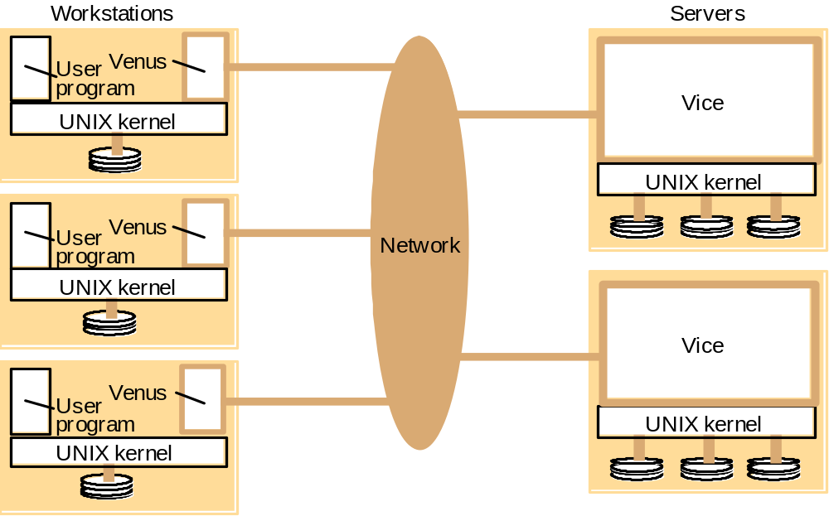
Case Study: The Andrew File System (AFS)
Figure 11. Distribution of processes in the Andrew File System
Couloris,Dollimore and Kindberg Distributed Systems: Concepts & Design Edn. 4 , Pearson Education 2005

Slide 27
Case Study: The Andrew File System (AFS)
The files available to user processes running on workstations are either local or shared. Local files are handled as normal UNIX files. They are stored on the workstation’s disk and are available only to local user processes. Shared files are stored on servers, and copies of them are cached on the local disks of workstations.
Couloris,Dollimore and Kindberg Distributed Systems: Concepts & Design Edn. 4 , Pearson Education 2005

Slide 28
Case Study: The Andrew File System (AFS)
The UNIX kernel in each workstation and server is a modified version of BSD UNIX. The modifications are designed to intercept open, close and some other file system calls when they refer to files in the shared name space and pass them to the Venus process in the client computer. (Figure 13)
Couloris,Dollimore and Kindberg Distributed Systems: Concepts & Design Edn. 4 , Pearson Education 2005

Slide 29
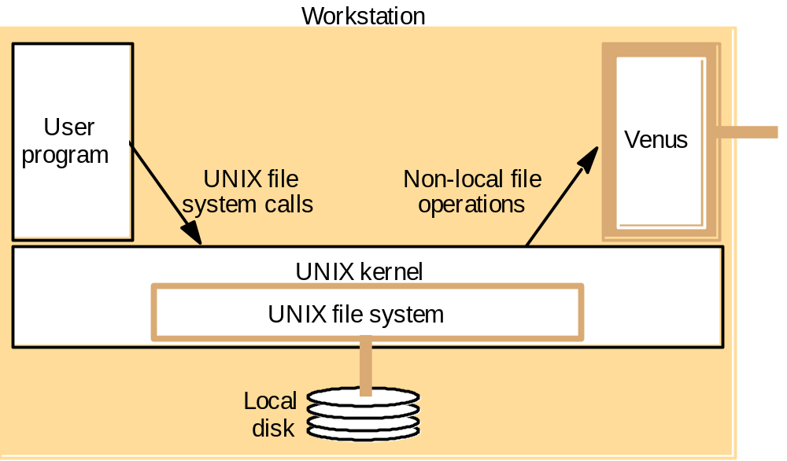
Case Study: The Andrew File System (AFS)
Figure 13. System call interception in AFS
Couloris,Dollimore and Kindberg Distributed Systems: Concepts & Design Edn. 4 , Pearson Education 2005

